Slide 1
Cis4360 / CIS5379 COMPUTER SECURITY FUNDAMENTALS
In 80 minutes ….

Slide 2
About the course
Class: CIS4360 CIS5379, Computer Security Fundamentals, in-person
Place: MCH0201 (Carothers Hall)
Times: Mo-We-Fr 12:00pm - 12:50pm
Instructor: Mike Burmester
Office hours: Mo-We 10:40am-11:30am, and by appointment
Assignments Points
Quizzes/Class Attendance/Participation 25%
Home Assignments 25%
Project 10%
Midterm 20%
Final 20%
All examinable materials are in
the slides
the Quizzes
the Home Assignments

Slide 3
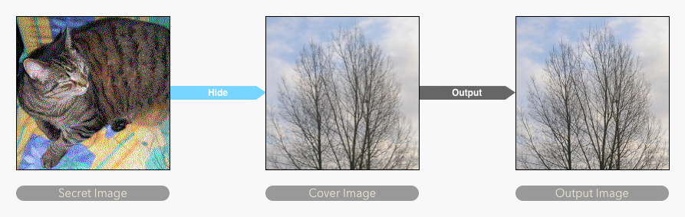
Definitions
Cryptography: the study of secret (κρυπτο) writing (γραφω)
Something cryptographers (security analysts) do …
Cryptanalysis: the analysis (ἀνάλυσις) of secret writing
Something cryptographers must do and hackers love doing
Cryptology: κρυπτο+λόγος, embraces cryptography and cryptanalysis
Steganography: the study of concealing (covering= στεγανος) messages/files/images, typically within other messages/files/ images/videos.
cryptology
cryptography cryptanalysis

Slide 4
hOW does cryptography WORK?
Develop algorithms that
conceal the context of messages from all except the sender and receiver (encryption for confidentiality or privacy),
verify the correctness of the message of the receiver (Integrity and authentication)
and much more …

Slide 5
Threat model Alice, Bob: honest Malory: adversary
Alice
Bob
message
CIA
Alice
Bob
message
Confidentiality (privacy)
CIA
Confidentiality
Integrity
Availability
Malory
Alice
Bob
message → message’
Integrity
& authenticity
Malory

Slide 6
Threat model Alice, Bob: honest Malory: adversary
Alice
Bob
message
CIA
Confidentiality
Integrity
Availability
Alice
Bob
Confidentiality
Integrity
message
Availability
Malory

Slide 7
Basic Concepts, glossary
cryptography: the art or science encompassing the principles and methods of transforming an intelligible message into one that is unintelligible, and then retransforming that message back to its original form
cryptanalysis: the study of principles and methods of transforming an unintelligible message back into an intelligible message without knowledge of the key. Also called codebreaking
cryptology: both cryptography and cryptanalysis
code: an algorithm for transforming an intelligible message into an unintelligible one using a code-book
plaintext: the original intelligible message
ciphertext: the transformed message
cipher: an algorithm for transforming an intelligible message into one that is unintelligible by transposition and/or substitution methods
key: some critical information used by the cipher, known only to the sender& receiver
encipher (encode): the process of converting plaintext to ciphertext using a key
decipher (decode): the process of converting ciphertext back into plaintext using a key
Confidentiality, Integrity and Availability, abbreviated to: CIA

Slide 8
cipher Attacks
Different types of attacks
ciphertext only
access only to some enciphered messages
use statistical analysis
known plaintext
know (or strongly suspect) some plaintext-ciphertext pairs
use this knowledge in attacking cipher
chosen plaintext
can select plaintext and obtain corresponding ciphertext
use knowledge of algorithm structure in attack
chosen plaintext-ciphertext
can select plaintext and obtain corresponding ciphertext, or select ciphertext and obtain plaintext
allows further knowledge of algorithm structure to be used
Passive vs active attacks
Ciphertext only attacks are passive attacks: the adversary is an eavesdropper (attempts to learn information).
Chosen plaintext-ciphertexts attacks are active attacks: the adversary sends selected messages or gets dencrypted selected ciphertexts (alters system resources).

Slide 9
Secret Key Cryptography
Symmetric (key) Encryption
encryption key ≈ decryption key
ciphertext = same length as plaintext
substitution ciphers, DES, AES, IDEA
Message transmission
agree on key (how?), communicate over insecure channel
Secure key storage: how?

Slide 10
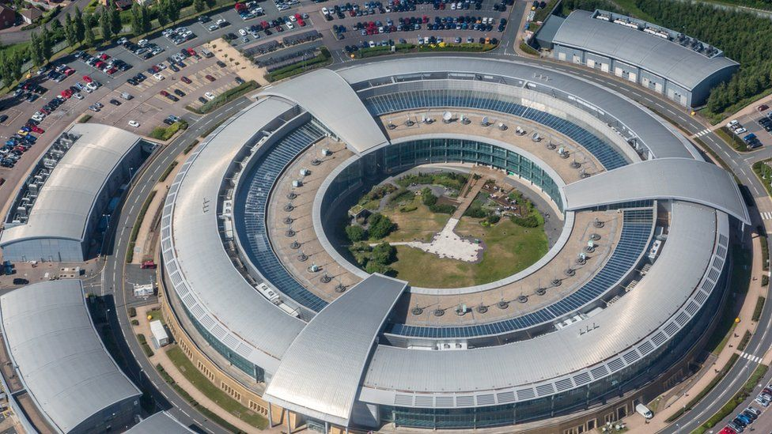
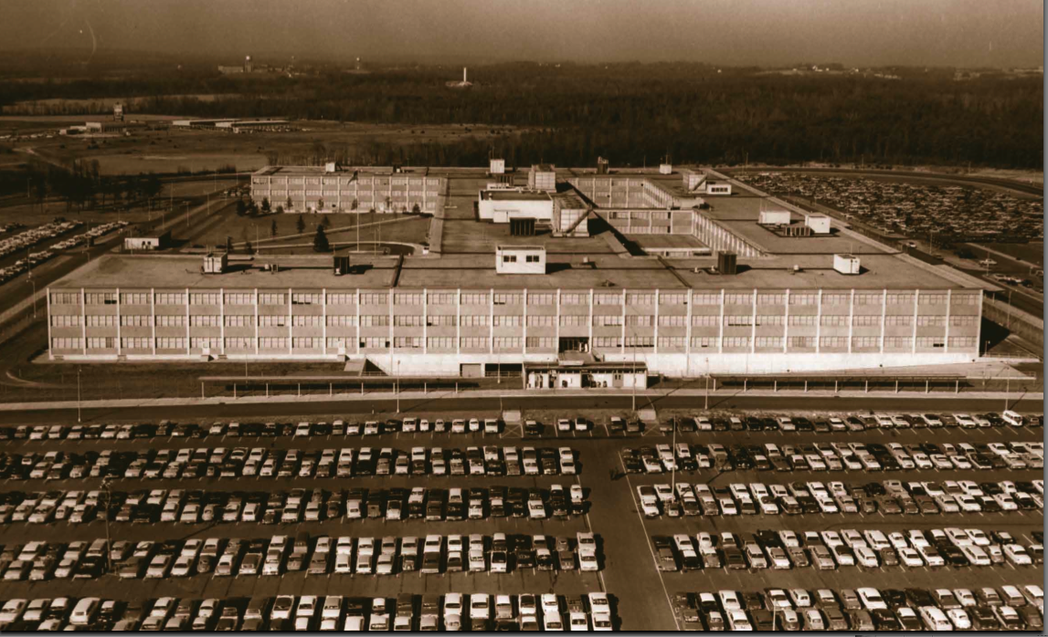

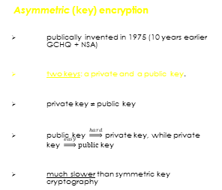
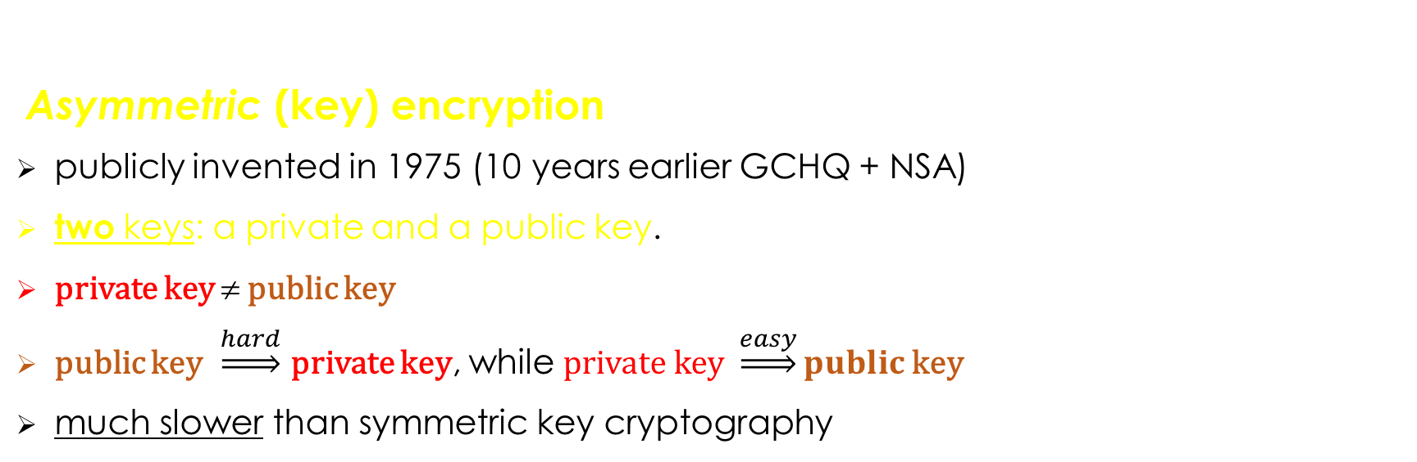
Public Key Cryptography
Asymmetric (key) encryption
publicly invented in 1975 (10 years earlier GCHQ + NSA)
two keys: a private and a public key.
private key ≠ public key
public key $\underset{⇒}{hard}$ private key, while private key $\underset{⇒}{easy}public$key
much slower than symmetric key cryptography
public key
private key
Asymmetric (key) encryption
publically invented in 1975 (10 years earlier GCHQ + NSA)
two keys: a private and a public key.
private key ≠ public key
public key $\underset{⇒}{hard}$ private key, while private key $\underset{⇒}{easy}public$key
much slower than symmetric key cryptography

Slide 11
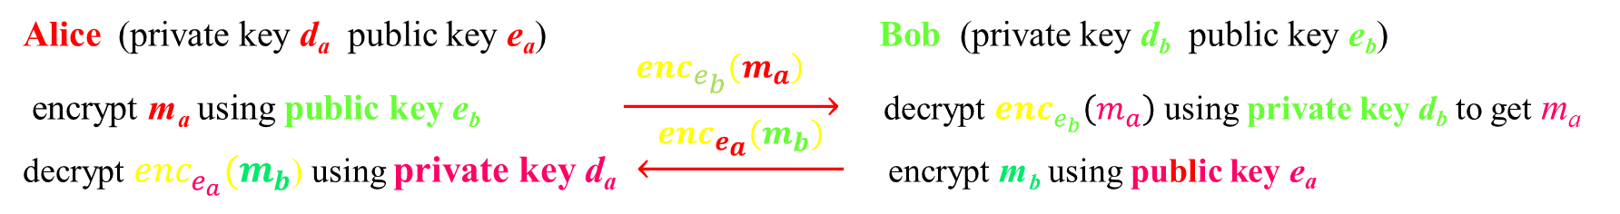

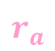
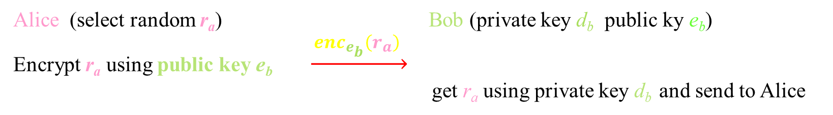
Public key cryptography
Privacy
Alice (private key d_{a} public key e_{a}) Bob (private key d_{b} public key e_{b})
encrypt m_{a} using public key e_{b} $\underset{→}{ {enc}_{e_{b}}\left(m_{a}\right) }$ decrypt ${enc}_{e_{b}}\left(m_{a}\right)$ using private key d_{b} to get m_{a}
decrypt ${enc}_{e_{a}}(m_{b}$) using private key d_{a} $\underset{←}{ {enc}_{e_{a}}\left(m_{b}\right) }$ encrypt m_{b} using public key e_{a}
secret keys: no need to share secret keys for secure communication
public key: Alice may share Bob’s public key e_{b} with his enemies
need to store safely secret keys
Authentication
Alice (select random r_{a}) Bob (private key d_{b} public ky e_{b}) Encrypt r_{a} using public key e_{b} $\underset{→}{ {enc}_{e_{b}}\left(r_{a}\right) }$
get r_{a} using private key d_{b} and send to Alice
$$r_{a}$$

Slide 12
Public Key Cryptography
That is, . . . .
Encryption:
Digital signature:
encrypt _{Public key Receiver} (plaintext)
Sender: plaintext
Receiver: Decrypt _{Private key Receiver} (ciphertext)
Signer: document +
signature _{Private key Signer} (hash(document))
Verifier: verification _{Public key Signer} [ document +
signature _{Private key Signer} (hash(document))] = TRUE OR FALSE
Asymmetric (key) encryption
publically invented in 1975 (10 years earlier GCHQ + NSA)
two keys: a private and a public key.
private key ≠ public key
public key $\underset{⇒}{hard}$ private key, while private key $\underset{⇒}{easy}public$key
much slower than symmetric key cryptography

Slide 13
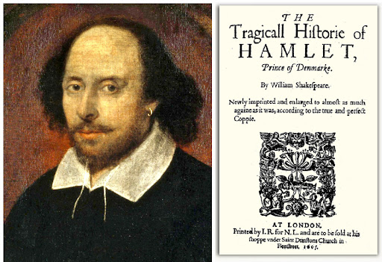
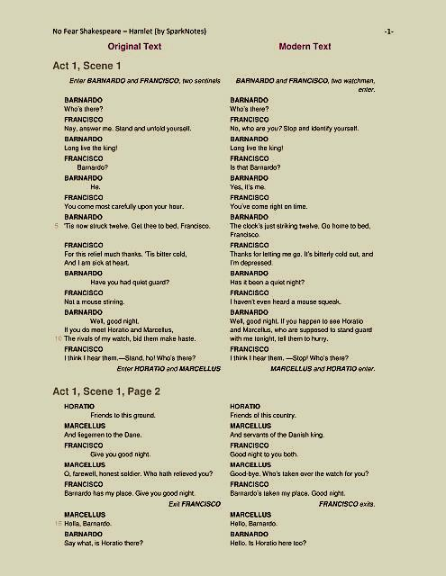
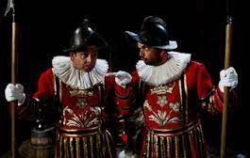
Public key cryptography
Authentication, an example
Sign/Countersign (challenge/response): a sign, word or signal exchanged between a sentry and anybody approaching their post.
1. World War II Sign/countersign (D-DAY)
Sign: flash
Password: thunder
Countersign: welcome
2. Shakespeare, Hamlet
Two sentinels: Bernardo & Fransisco enter
(Bernardo) Who’s there?
(Fransisco) Nay, answer me: Stand and unfold yourself
(Bernardo) Long live the king!
(Fransisco) Bernardo?
5. (Bernardo) He
6. (Fransisco) You come most carefully upon your hour
7. (Bernardo) Tis now struck twelve. Get thee to bed Fransisco

Slide 14
Unconditional & Computational Security
There are two fundamentally different ways ciphers may be secured
unconditionally
no matter how much computer power is available, the cipher cannot be broken
computationally
given limited computing resources (e.g. the time needed for calculations is greater than age of universe), the cipher cannot be broken

Slide 15
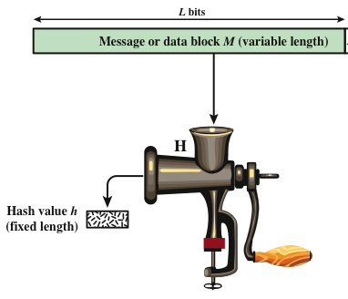
Hash Functions
A hash function H accepts a variable-length block of data M as input and produces a fixed-size hash value: h = H(M)
Cryptographic hash function: An algorithm for which it is computationally infeasible to find either:
a data object that maps to a pre-specified hash result (one-way property)
two data objects that map to the same hash result
(collision-free property)
(variable length)

Slide 16
Digital signatures
Alice digitally signs the hash of a message h(m_{A}) with her private signature key d_{a}
Bob verifies the digital signature of Alice by using her public verifying key e_{a}
Digital signatures guarantee,
authorship
integrity
non-repudiation: can’t do this with symmetric key cryptography

Slide 17
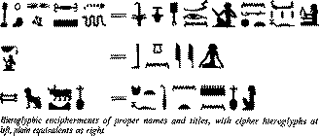


A Brief History of classical cryptography
Ancient Ciphers
history of at least 4000 years
ancient Egyptians enciphered some of their hieroglyphs (Greek word: “sacred carvings”)
�
watchful
man
Hieroglyphic encipherments of proper names and titles with cipher hieroglyphs at left, plain equivalents at right

Slide 18
A Brief History of classical cryptography
Ancient Ciphers
2000 years ago Julius Caesar used a simple substitution cipher
Roger Bacon described several methods in 1200s
Geoffrey Chaucer included several ciphers in his works
Blaise de Vigenère published a book on cryptology in 1585, & described the polyalphabetic substitution cipher
increasingly used, especially in diplomacy & war over centuries

Slide 19
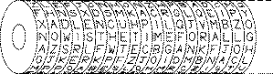
Machine ciphers
Jefferson cylinder, developed in 1790s, comprised 36 disks, each with a random alphabet, order of disks was key, message was set, then another row became cipher
N O W I S T H E …
A Z S R L F W T E …

Slide 20
Classical Cryptographic Techniques
Have two basic components: substitution and transposition
in substitution cipher’s letters are replaced by other letters
in transposition ciphers the letters are arranged in a different order
Classical cryptographic ciphers may be:
monoalphabetic - only one substitution/transposition is used
polyalphabetic - several substitutions/transpositions are used
several such ciphers may be concatenated to form a product cipher

Slide 21
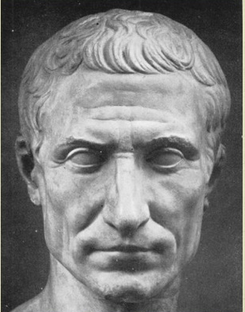
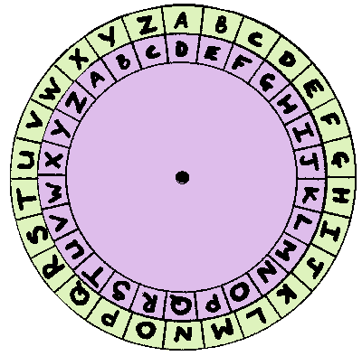
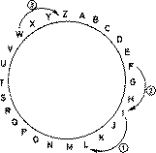
Caesar Cipher - a monoalphabetic cipher
replace each letter of message by a letter a fixed distance away e.g. use the 3rd letter on
reputedly used by Julius Caesar
example
I CAME I SAW I CONQUE R E D
L F D P H L VDZ L F R Q T XHUHG
A roman emperor, credited with building the Roman empire
Used the Ceasar cipher, a substitution cipher for secret communicate

Slide 22
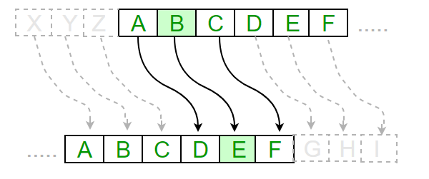
For key C=3, ROT3 (right)
Plain: A B C D E F G H I J K L M N O P Q R S T U V W X Y Z
Cipher: D E F G H I J K L M N O P Q R S T U V W X Y Z A B C
EXAMPLE
Plain: A T T A C K
Cipher: D
D W W
D W W D
D W W D F
D W W D F N

Slide 23
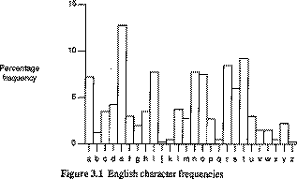
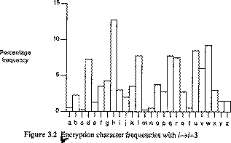
Cryptanalysis of the Caesar Cipher
only 26 possible ciphers
could simply try each in turn - exhaustive key search
also can use letter frequency analysis

Slide 24
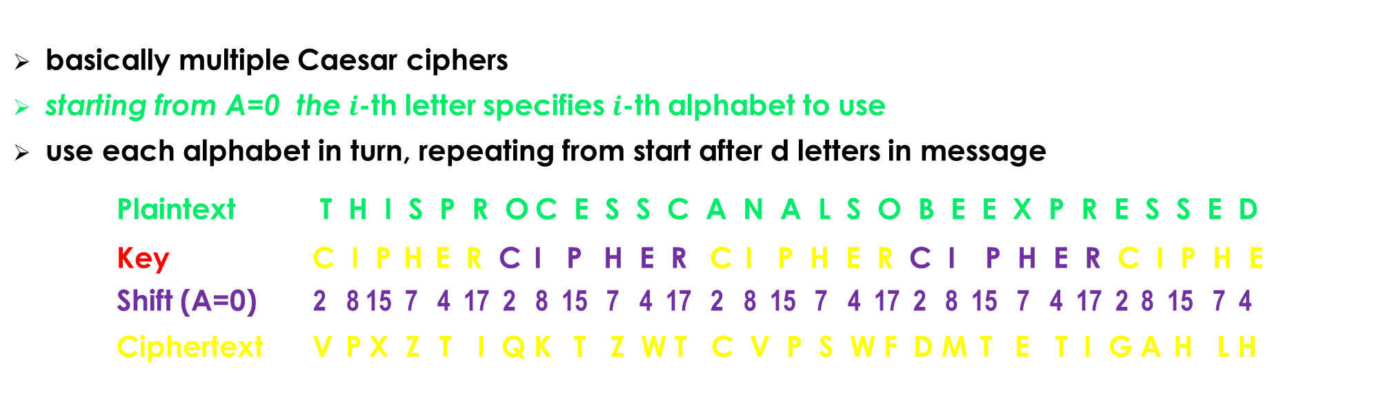
Polyalphabetic Substitution, Vigenère Cipher
basically multiple Caesar ciphers
starting from A=0 the $i$-th letter specifies $i$-th alphabet to use
use each alphabet in turn, repeating from start after d letters in message
Plaintext T H I S P R O C E S S C A N A L S O B E E X P R E S S E D
Key C I P H E R C I P H E R C I P H E R C I P H E R C I P H E
Shift (A=0) 2 8 15 7 4 17 2 8 15 7 4 17 2 8 15 7 4 17 2 8 15 7 4 17 2 8 15 7 4
Ciphertext V P X Z T I Q K T Z W T C V P S W F D M T E T I G A H L H

Slide 25
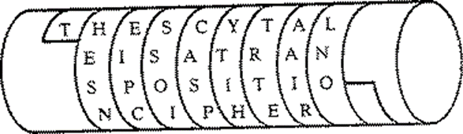
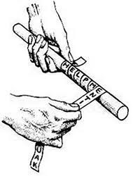
Transposition Ciphers
Transposition or permutation ciphers hide the message contents by rearranging the order of the letters
Scytale cipher
an early Greek transposition cipher
a strip of paper was wound round a staff
message written along staff in rows, then paper
removed leaving a strip of seemingly random letters
not very secure as key was width of paper & staff

Slide 26
Transposition ciphers
Write message in a number of columns and use some rule to read off from these columns
Key could be a series of numbers being the order to: read off the cipher, or write in the plaintext
Plain: THESIMPLESTPOSSIBLETRANSPOSITIONSXX
Key: 2 5 4 1 3
T H E S I
M P L E S
T P O S S
I B L E T
R A N S P
O S I T I
O N S X X
Cipher: SESESTX TMTIROO ISSTPIX ELOLNIS HPPBASN

Slide 27
Cryptanalysis of Row Transposition ciphers
a frequency count will show a normal language profile
hence we know how letters rearranged
basic idea is to guess period, then look at all possible permutations in period, and search for common patterns
use lists of common pairs & triples & other features

Slide 28
Product ciphers
In general ciphers based on just substitutions or just transpositions are not secure
What about combining several ciphers?
two substitutions are really only one more complex substitution
two transpositions are really only one more complex transposition
but a substitution followed by a transposition makes a new much harder cipher
PRODUCT CIPHERS consist of chained substitution-transposition combinations
In general these are far too hard to do by hand
One famous Product Cipher, the 'ADFGVX' cipher, was used in WW1
However this could easily be broken with calculating machines.
One had to wait for the invention of the Cipher Machine, particularly the rotor machines (eg the Enigma mentioned earlier) to get codes that needed computers to be broken

Slide 29
ADFGVX Product Cipher
Named so, because only the letters ADFGVX are used
Chosen since they have very distinct Morse codes
Uses:
a fixed substitution table to map each plaintext letter to a letter pair, then
a keyed block transposition

Slide 30
ADFGVX Product Cipher – a. substitution table
A D F G V X
A K Z W R 1 F
D 9 B 6 C L 5
F Q 7 J P G X (this matrix was public)
G E V Y 3 A N
V 8 O D H 0 2
X U 4 I S T M
Plaintext: P R O D U C T C I P H E R S
Intermediate Text:
FG AG VD VF XA DG XV DG XF FG VG GA AG XG

Slide 31
ADFGVX Product Cipher -- B. Keyed Transposition
2 3 7 6 5 1 4 Sorting Order Key
F G A G V D V
F X A D G X V
D G X F F G V
G G A A G X G
Intermediate Text: FG AG VD VF XA DG XV DG XF FG VG GA AG XG
Ciphertext: DXGX FFDG GXGG VVVG VGFG CDFA AAXA

Slide 32
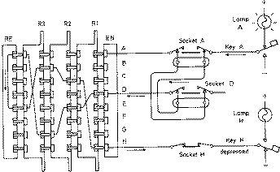
enigma
Enigma Rotor machine, one of a class of cipher machines, used during WWII, comprised a series of rotor wheels with internal cross-connections, providing a substitution using a continuously changing alphabet

Slide 33
Wireless & Cellular Communication Networks from 1G to 5G
~2.5 cells

Slide 34
1G Advanced Mobile Phone Services (AMPS) architecture
Public Switching Telephone Network
Mobile Telephone Switching Office

Slide 35
2G Global System for Mobile Communication (GSM) architecture
(base and switching interface)
(B,C,D,H,F,G,H
other interfaces)
(air interface)
Public Swit Tel Netw
Integr Serv Digit Netw
Mobile Stat Subsystem
Base Stat Subsystem
Network Switching System

Slide 36

3G Universal Mobile Telecommunications Service (UMTS) architecture
Mobile Serv Center/
Visitor Locat Register
Home Location Service
Radio Net Contr
Serving GPRS
Support Network
Gateway GPRS
Support Network
Mob Stat Subsystem
(Core Network)
(Universal Terrestrial Radio Access Network)

Slide 37
4G Long Term Evolution (LTE) Network architecture
Mob Manage Entity
enhanced Node B

Slide 38
5G Non-standalone architecture (NSA)

Slide 39
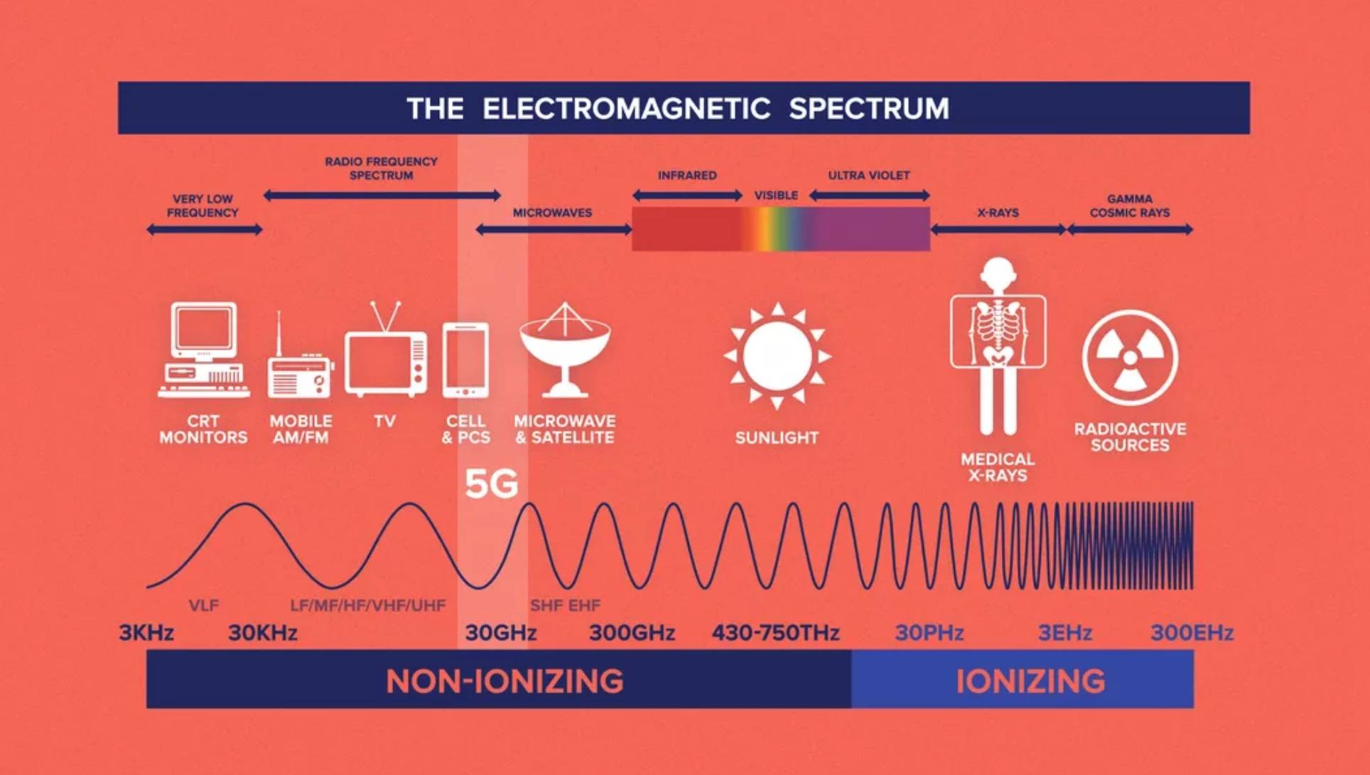
1G-5G
900 MHz-300 GHz
5G high frequency band: millimeter wave 300+ GHs
Very High Frequency, VHF 30 to 300 MHz
Ultra High Frequency UHF 300 to 3000 MHz
Super High Frequency SHF 3 to 30 GHz
Extremely High Frequency EHF 30 to 300 GHz

Slide 40
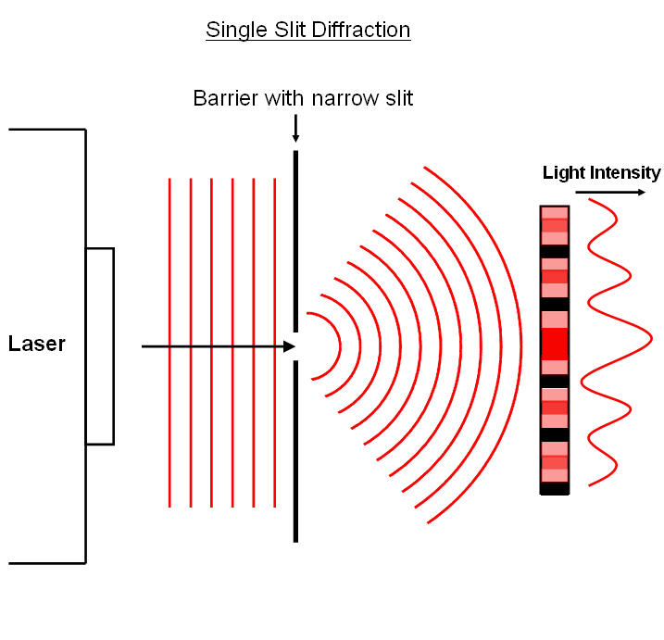
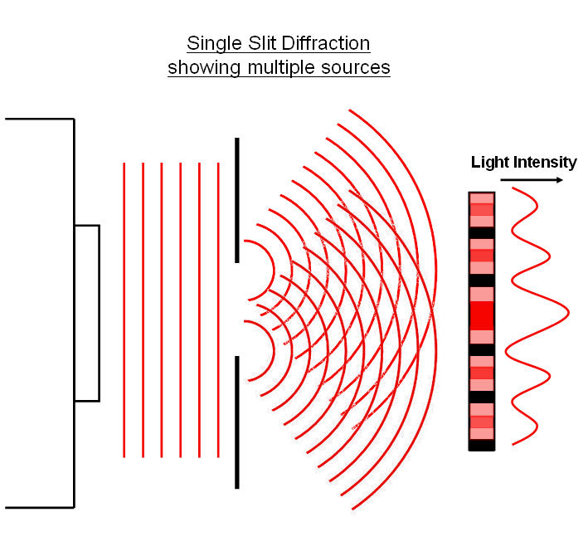
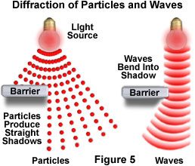
CaBle or wireless The Wave-Particle Duality Principle & the Uncertainty Principle
Wave-Particle Duality Principle: light behaves both like
(Heisenberg duality principle)
a wave (diffraction)
a particle (photon = bundle of energy)
Does not need a medium to travel

Slide 41
CaBle or wireless The Wave-Particle Duality Principle & the Uncertainty Principle
Entanglement between particle and wave state
Heisenberg’s duality principle
there is a natural tradeoff between knowing a particle's
position and its
momentum (speed).
The greater the uncertainty in it's position, the smaller the uncertainty in its momentum.
It is impossible to predict, measure, or know both the exact position of a particle and its exact momentum at the same time.
In fact, a particle does not have an exact position and momentum at the same time!
particle
wave

Slide 42
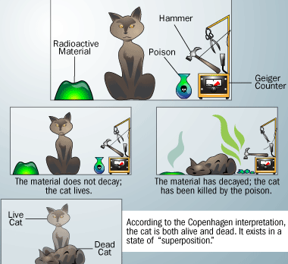
CaBle or wireless The Wave-Particle Duality Principle & the Uncertainty Principle
Entanglement between particle and wave state
Schrodinger’s Cat (thought experiment)
A cat is locked in a steel box along with a Geiger counter a tiny bit of radioactive substance, and some poison. You would not know if the cat is alive or dead until you open the box. In this sense the cat is dead and alive and its state can only be determined until “tested”.
Entanglement-based secure quantum cryptography

Slide 43

QUANTUM CRYPTO
Quantum cryptography
Schroedinger’s thought experiment
Alice and Bob want to exchange a random 4 bit key
Alice is on earth, Bob is a satellite
Use black and white cats, 4 steel boxes.
If a box is tempered this can be recognized.
Bob opens the boxes and finds that all cats are alive with the first three white and the last black. Then the 4 bit key is:${ b}_{1}=0,$ $b_{2}=0,$ $b_{3}=0,$ $b_{4}=1.$
No tempering: the key is: $0001$
Boxes 1,3 are tempered: keep $b_{2}=0,b_{4}=1,$ and ask for 2 more boxes.

Slide 44
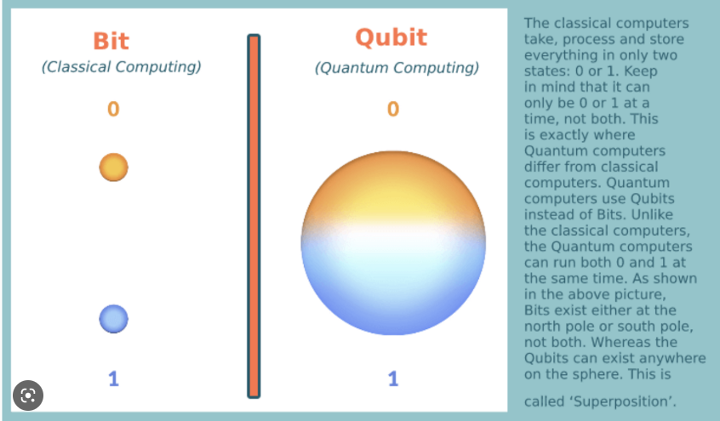
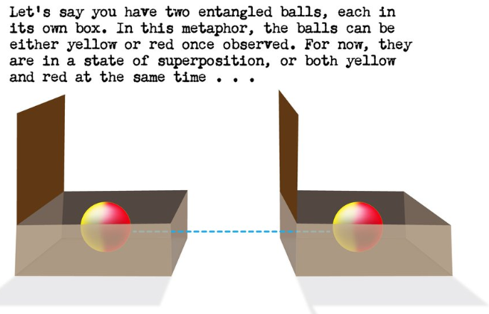
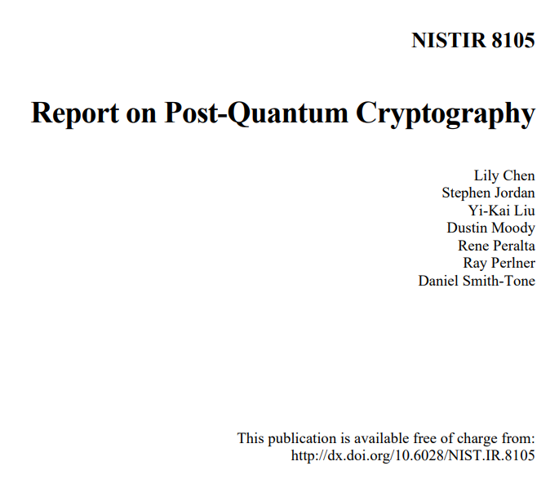
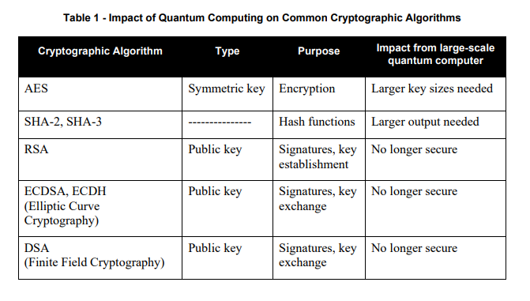
QUANTUM CRYPTO
Quantum cryptography
Qubits
Superposition
Entanglement
NISTIR 8105

Slide 45
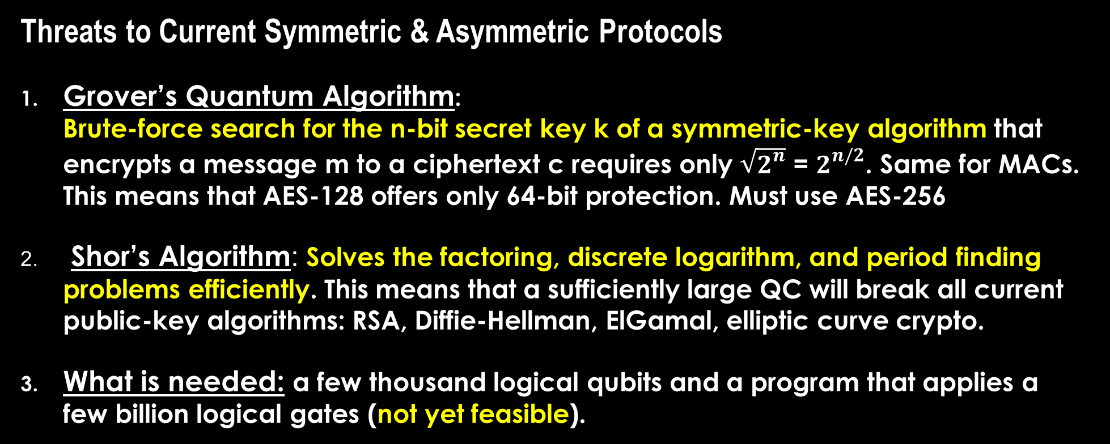
Quantum computing
Threats to Current Symmetric & Asymmetric Protocols
Grover’s Quantum Algorithm: Brute-force search for the n-bit secret key k of a symmetric-key algorithm that encrypts a message m to a ciphertext c requires only $\sqrt{2^{n}}$ = $2^{n/2}$. Same for MACs. This means that AES-128 offers only 64-bit protection. Must use AES-256
Shor’s Algorithm: Solves the factoring, discrete logarithm, and period finding problems efficiently. This means that a sufficiently large QC will break all current public-key algorithms: RSA, Diffie-Hellman, ElGamal, elliptic curve crypto.
What is needed: a few thousand logical qubits and a program that applies a few billion logical gates (not yet feasible).

